Slide 1
MySQL Data Types
A database table contains multiple columns with specific data types such as numeric or string. MySQL provides more data types other than just numeric or string. Each data type in MySQL can be determined by the following characteristics:
The kind of values it represents.
The space that takes up and whether the values is a fixed-length or variable length.
The values of the data type can be indexed or not.
How MySQL compares the values of a specific data type.

Slide 2
About Me
Ritesh Singh
Sun Certified java Professional
Oracle Certified Database Administrator
Certified Ethical Hacker
Certified EC-Council Instructor (CEI)

Slide 3
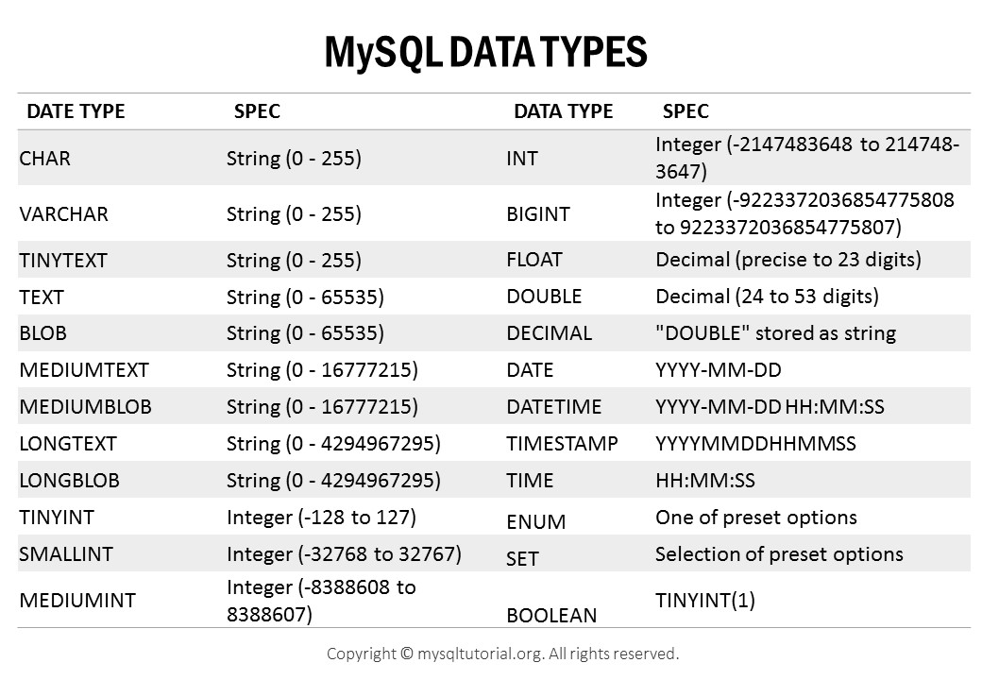

Slide 4
MySQL numeric data types
In MySQL, you can find all SQL standard numeric types including exact number data type and approximate numeric data types including integer, fixed-point and floating point. In addition, MySQL also hasBIT data type for storing bit values. Numeric types can be signed or unsigned except for the BIT type.

Slide 5
The following table shows the summary of numeric types in MySQL:
The following table shows the summary of numeric types in MySQL:
Numeric Types | Description
TINYINT | A very small integer
SMALLINT | A small integer
MEDIUMINT | A medium-sized integer
INT | A standard integer
BIGINT | A large integer
DECIMAL | A fixed-point number
FLOAT | A single-precision floating point number
DOUBLE | A double-precision floating point number
BIT | A bit field

Slide 6
MySQL Boolean data type
MySQL does not have the built-in BOOLEANor BOOL data type. To represent Boolean values, MySQL uses the smallest integer type which isTINYINT(1). In other words, BOOLEAN and BOOL are synonyms for TINYINT(1).
MySQL String data types
In MySQL, a string can hold anything from plain text to binary data such as images or files. Strings can be compared and searched based on pattern matching by using the LIKE operator, regular expression, and full-text search.

Slide 7
The following table shows the string data types in MySQL:
The following table shows the string data types in MySQL:
String Types | Description
CHAR | A fixed-length nonbinary (character) string
VARCHAR | A variable-length non-binary string
BINARY | A fixed-length binary string
VARBINARY | A variable-length binary string
TINYBLOB | A very small BLOB (binary large object)
BLOB | A small BLOB
MEDIUMBLOB | A medium-sized BLOB
LONGBLOB | A large BLOB
TINYTEXT | A very small non-binary string
TEXT | A small non-binary string
MEDIUMTEXT | A medium-sized non-binary string
LONGTEXT | A large non-binary string
ENUM | An enumeration; each column value may be assigned one enumeration member
SET | A set; each column value may be assigned zero or more SET members

Slide 8
The following table illustrates the MySQL date and time data types:
MySQL date and time data types
MySQL provides types for date and time as well as the combination of date and time. In addition, MySQL supports timestamp data type for tracking the changes in a row of a table. If you just want to store the year without date and month, you can use the YEAR data type.

Slide 9
The following table illustrates the MySQL date and time data types:
Date and Time Types | Description
DATE | A date value in CCYY-MM-DD format
TIME | A time value in hh:mm:ss format
DATETIME | A date and time value inCCYY-MM-DD hh:mm:ssformat
TIMESTAMP | A timestamp value in CCYY-MM-DD hh:mm:ss format
YEAR | A year value in CCYY or YY format

Slide 10
MySQL spatial data types
MySQL supports many spatial data types that contain various kinds of geometrical and geographical values as shown in the following table:
atial Data Types | Description
GEOMETRY | A spatial value of any type
POINT | A point (a pair of X-Y coordinates)
LINESTRING | A curve (one or more POINT values)
POLYGON | A polygon
GEOMETRYCOLLECTION | A collection of GEOMETRYvalues
MULTILINESTRING | A collection of LINESTRINGvalues
MULTIPOINT | A collection of POINTvalues
MULTIPOLYGON | A collection of POLYGONvalues

Slide 11
JSON data type
MySQL supported a native JSON data type since version 5.7.8 that allows you to store and manage JSON documents more efficiently. The native JSON data type provides automatic validation of JSON documents and optimal storage format.

